Slide 1
Project :: Eduscape Eduscape
Design Pattern : Abstract Factory
Submitted by:
1. NASif Zaman (1305030)
2. Muhit Imon (1305036)
3. Abrar masum shanto (1305048)
4.Mohammad faisal(1505056)
5 fahim hasnain fahad(1305060)

Slide 2
Abstract Factory Method Introduction :
known as a creational pattern
used to construct objects such that they can be decoupled from the implementing system.
Clients never create platform objects directly

Slide 3
Intent:
Provide an interface for creating families of related or dependent objects without specifying their concrete classes.
Abstract Factory pattern, a class delegates the responsibility of object instantiation to another object via composition
A hierarchy that encapsulates: many possible "platforms", and the construction of a suite of "products".

Slide 4
Problem : When to apply
When we have to create multiple families of products.
When we want to provide a library of products without exposing the implementation details.
When the system needs to be independent from the way the products it works with are created.
When we want to make our code portable

Slide 5
Solution : How it is applied
The Abstract Factory defines a Factory Method per product.
Each Factory Method encapsulates the new operator and the concrete, platform-specific, product classes.
Each "platform" is then modeled with a Factory derived class.

Slide 6
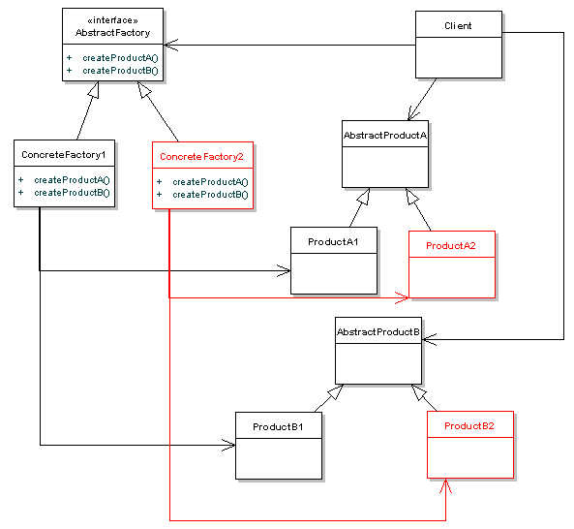
Elements in the design

Slide 7
Example : Name-Address
<<Interface>>
AbstarctFactory
+ createPhoneNumber()
+ createAddress()
Client
BDInfo
+ createPhoneNumberBD()
+ crreateAddressBD()
<<Interface>>
AbstractPhoneNumber
USInfo
+ createPhoneNumberUS()
+ crreateAddressUS()
PhoneNumberBD
PhoneNumberUS
<<Interface>>
AbstractAddress
AddressBD
AddressUS

Slide 8
Example : Implementation on our System
<<Interface>>
AbstractFactoryTrainer
+ makeTutorial()
+ makeQuestions()
Client
PhysicsTrainer
+ makePhysicsTutorial()
+ makePhysicsQuestions()
<<Interface>>
AbstractTutorial
ICTTrainer
+ makeICTTutorial()
+ makeICTQuestions()
PhysicsTutorial
ICTTutorial
<<Interface>>
AbstractQuestions
PhysicsQuestions
ICTQuestions

Slide 9
Consequences: Benefits
Decouples Clients from concrete Products.
New product families can be easily added into the system, by just adding in a new type of ConcreteFactory that implements AbstractFactory, and creating the specific Product implementations.

Slide 10
Thank you

